Slide 1
Legal Department

Slide 2
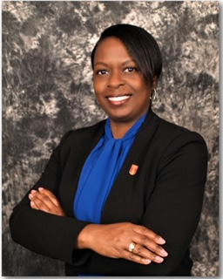
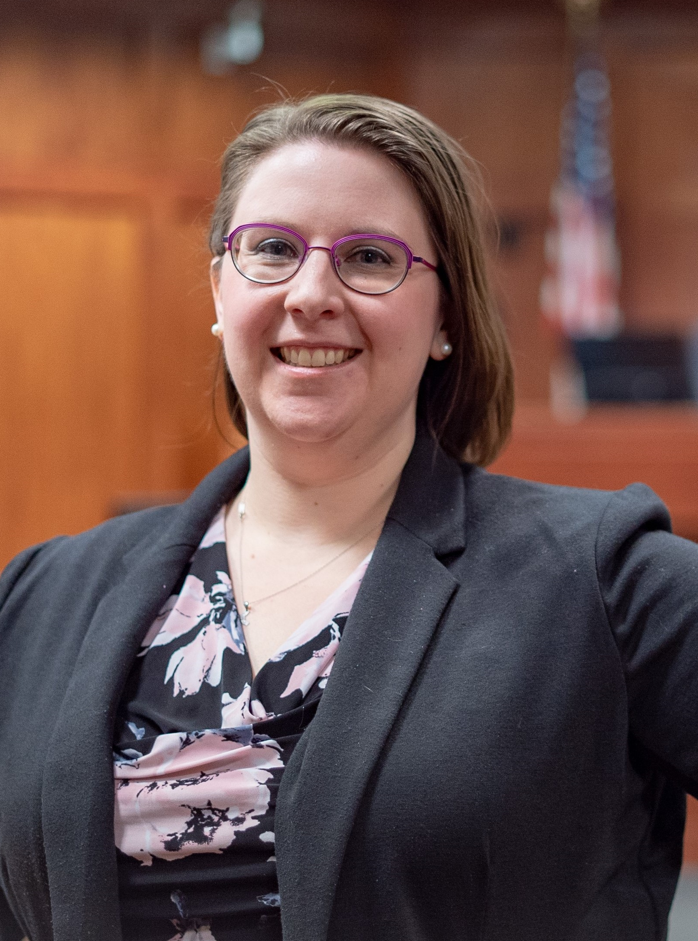
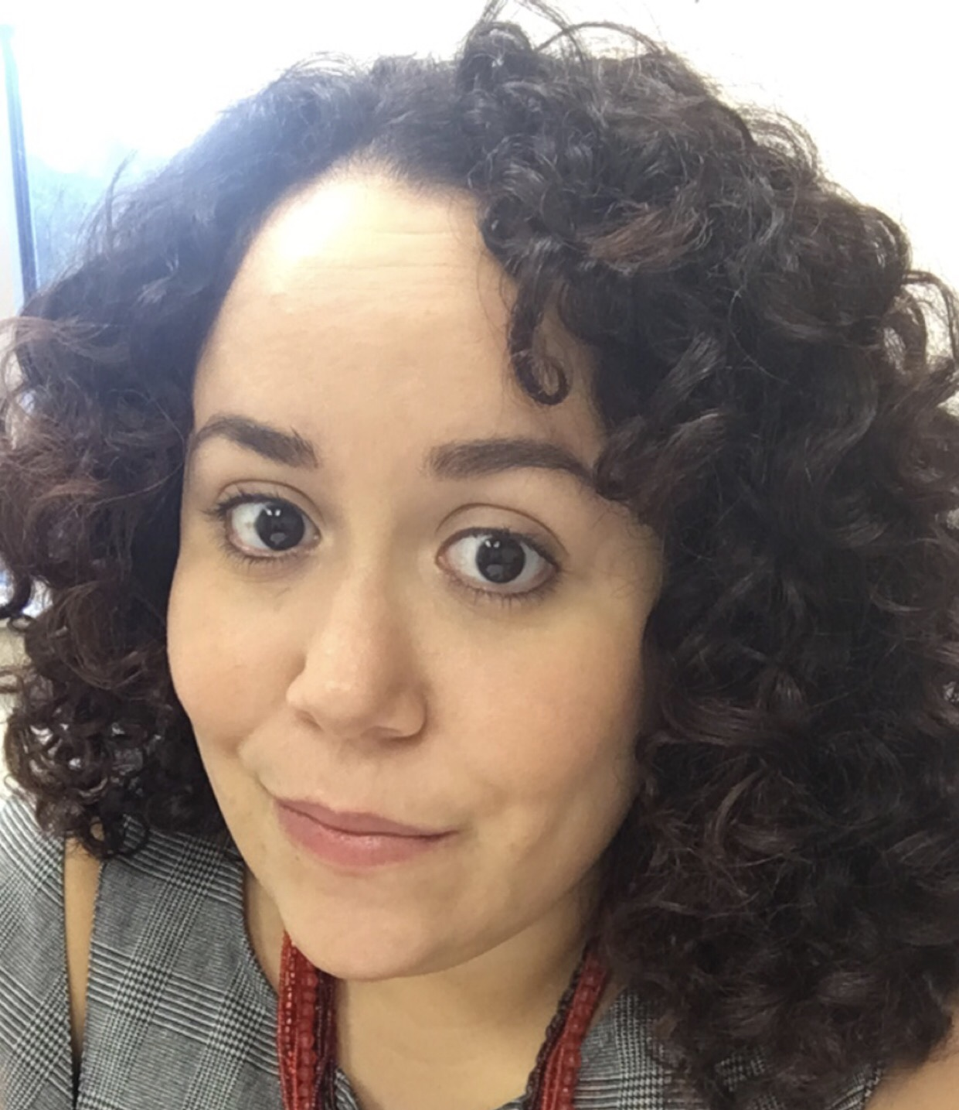
THE TEAM
Natalia S. Harris City Attorney
Amelia Bean-DeFlumer City Prosecutor
ASSISTANT CITY PROSECUTORS:
Alicia Harris Tyler Sanders

Slide 3
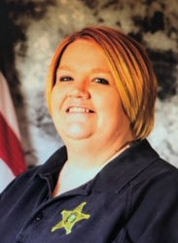
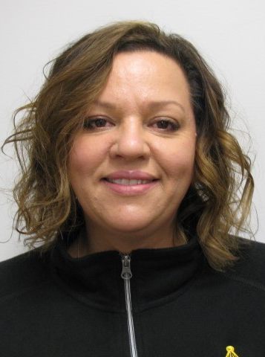
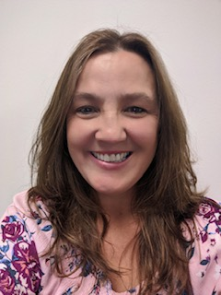
THE TEAM
VICTIM ADVOCATES: ADMINISTRATIVE ASSISTANTS:
Valerie Hooper Neddy Stark-Jones Veronica Hetzner Tina Johns

Slide 4
LEGAL DEPARTMENT
CITY MANAGER
CITY ATTORNEY
CIVIL
CITY PROSECUTOR
CRIMINAL

Slide 5
CITY ATTORNEY

Slide 6
The City Manager shall appoint a City Attorney who shall be the chief law officer of the City…she shall be the legal advisor of and attorney and counsel for the City and for all officers and departments thereof in all matters relating to their official duties and powers.
Don’t advise the public.

Slide 7
Q: What does that look like?
A: More than 650 Requests for Legal Services
Legislation
Contracts and other instruments
Opinions (formal and informal)
Advise
Legal proceedings
Public records requests
Training

Slide 8
CITY prosecutor

Slide 9
WHAT WE DO:
WHAT WE DON’T DO:
Prosecute all misdemeanor offenses that occur in Delaware County
Traffic and Criminal
Diversion Program
Victim Advocacy
Specialty Court Dockets
Prosecute any felony cases.
Provide legal advice to the public.

Slide 10
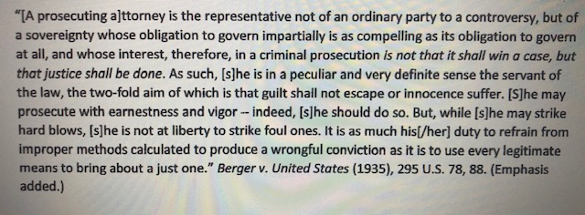
OUR MISSION STATEMENT:

Slide 11
CASE EVALUATION
Charges
Elements of the offense(s)
Evidence (statements, witnesses, documents, photos, recordings)
Egregiousness of the offense
Victim’s position
Arresting officer’s position
Likelihood of success at trial

Slide 12
CASE PROCESS
Arraignment
Telephonic pretrial with defense attorney
Pretrial motions (competency, suppression)
Final pretrial/plea
Trial
Sentencing

Slide 13
2020
2021
2022
2019
2023
3,100 cases prosecuted
25 Jury Trials
2,000 cases
prosecuted
17 Jury Trials
2,150 cases
prosecuted
10 Jury Trials
1,483 cases
prosecuted
13 Jury Trials
1,891 cases
prosecuted
7 Jury Trials

Slide 14
DIVERSION PROGRAM
Eligible Offenses:
Theft
Underage Possession/Consumption of Alcohol
Possession of Marijuana/Marijuana paraphernalia
Delaware City Income tax violations
Eligibility:
No previous criminal convictions as an adult
No prior participation in a Diversion program
No prior alcohol related traffic convictions
No pending criminal or alcohol related traffic offenses
Outcome: Case is dismissed if successfully completed

Slide 15
DIVERSION PROGRAM
Requirements:
Must enter a guilty plea to the offense(s).
Pay a Diversion fee and associated court costs.
Complete 20 hours of community service at a non-profitable, charitable, or government organization.
Complete an education program as directed by the Prosecutor’s Office.
Cannot be charged with any criminal or alcohol related traffic offense during your participation in the program.
Subject to random drug and alcohol testing while participating in
the program.

Slide 16
QUESTIONS

Slide 17
Economic Development
February 29, 2024

Slide 18
The Role
What Is a local government Economic Developer?
A city government employee who helps spur the city economy.
Two biggest responsibilities are to persuade new businesses to move into your town and encourage existing businesses to expand.
Make connections with potentially valuable economic partners.
Duties include developing strategic programs for economic and financial growth, analyzing market trends, and advise the city manager and the city council.

Slide 19
The Goal
Foster new job opportunities
Allowing our residents to have a stable income or career advancement, ultimately enhancing their quality of life.
Increase tax revenue
Allowing for investments in essential services such as education, infrastructure, and public safety – that benefit all citizens.
Develop a diversified economy
While also fostering greater innovation and competition, empowering the community to be more resilient to economic headwinds as they come.
Create a vibrant economy
A vibrant economy boosts property values, attracts skilled workers, and encourages cultural and recreational activities, making the community a more attractive place.

Slide 20
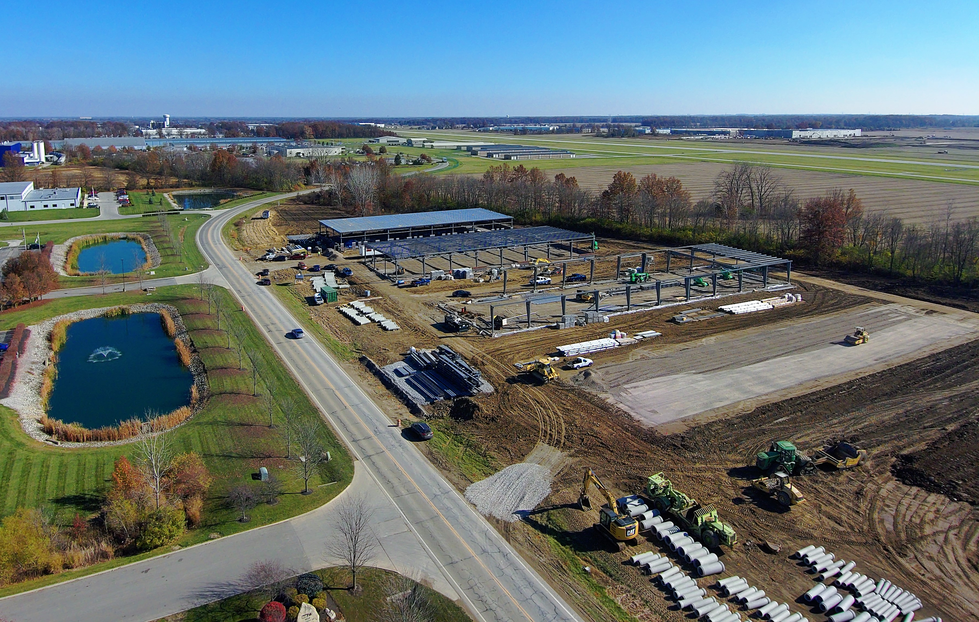
Projects
Manages about 200 projects each year
2022
The new and expanded companies expected to hire 282 new full timers
The 282 jobs expected to lead to $12,742,835 in new payroll.
This will generate $235,743 in new income taxes for City services annually
Business Retention and Expansion
Economic Development staff met with 50-60 businesses each year, providing a variety of services and assistance

Slide 21
Delaware Entrepreneurial Center
Business incubator
Opened in 2018 at Ohio Wesleyan
First-of-its-kind city, county, and educational institute partnership
Has seen 11 companies grow and graduate; 45 new, full-time jobs added to the local income tax base; more than $3.7 million in investments and grants awarded to center members.
Created with a five-year agreement and $50,000 annual investment from the city and county.
owu.edu/delaware-entrepreneurial-center.

Slide 22
Sawmill Pointe Business Park
Sawmill Parkway completion in 2024 to Section Line Road
Entire 89-acre Sawmill Pointe Business Park projected to house nearly 1.3 million SF of buildings

Slide 23
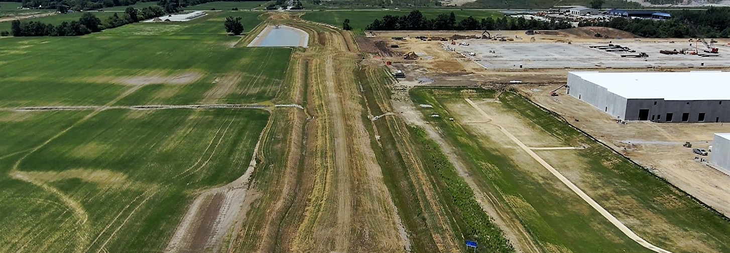
Sawmill Pointe Business Park

Slide 24
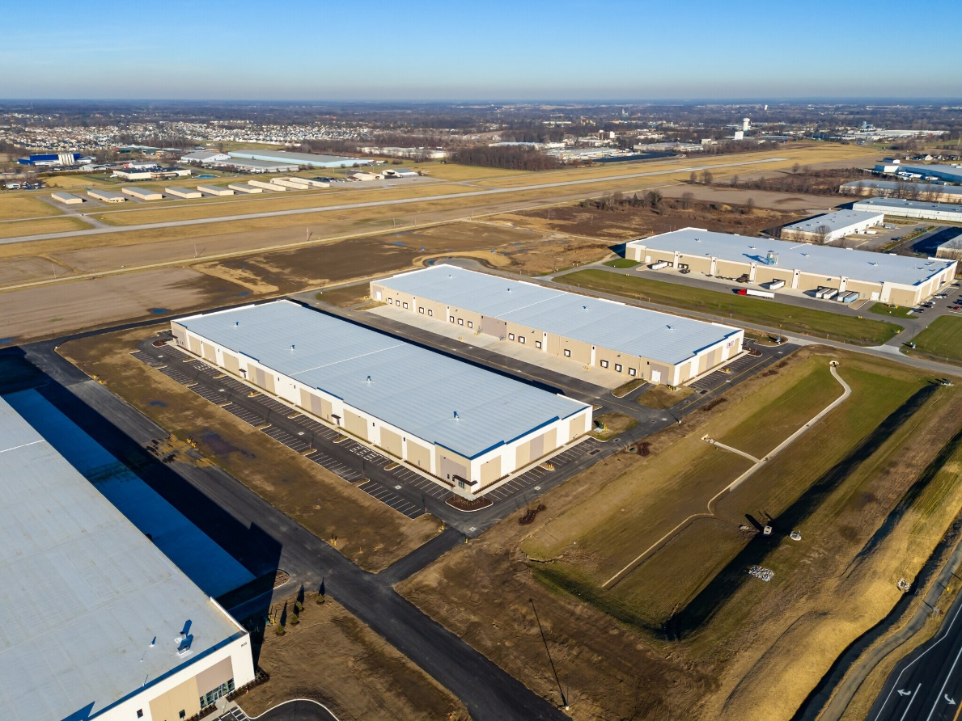
Sawmill Pointe Business Park
Expanding Delaware’s ‘breadbasket’
4 new buildings; two already occupied by
Inno-Pak

Slide 25
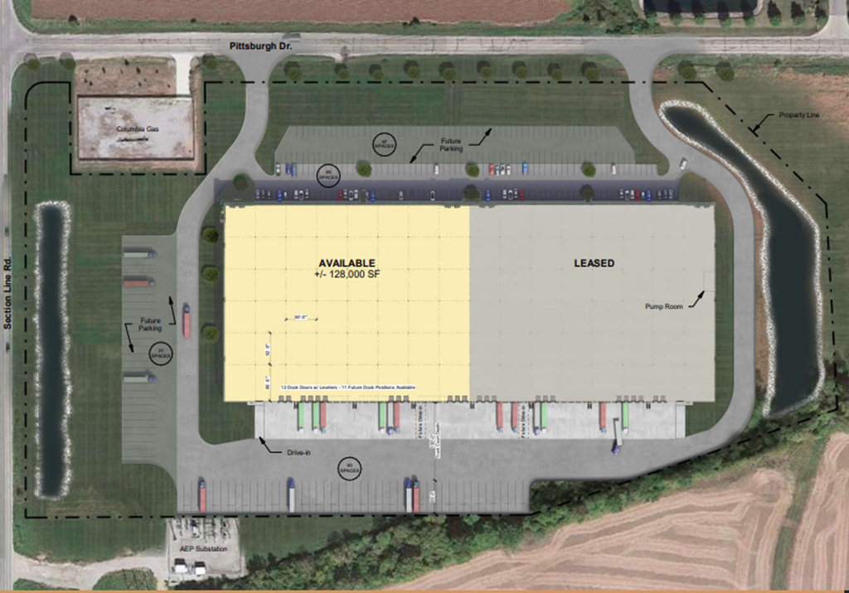
On the Horizon
Attindas Hygiene Partners; $20 million investment and 50 new jobs
255,000 SF at Section Line & Pittsburgh Dr.
Half of building recently leased by Luvata Inc., creating 40 new jobs with $3.2 million in new payroll
Last parcel availble

